Slide 1
【TIPS】
The Influence of Drawing Process on the Properties of Prestressed Steel Wire
May 28, 2026

Slide 2
Contens
01/
02/
The Influence of Drawing Process on the Performance of Prestressed Steel Wire
The Influence of Drawing Passes and Area Reduction per Pass on the Performance of Steel Wire
03/
04/
The Influence of Simplified Drawing Processes
Mechanism of the Effect of Drawing Speed on Metallographic Structure
05/
06/
Engineering Hazards Caused by Non-Standard Drawing Processes
Our Process & Quality Assurance

Slide 3
The Influence of Drawing Process on the Performance of Prestressed Steel Wire
01

Slide 4
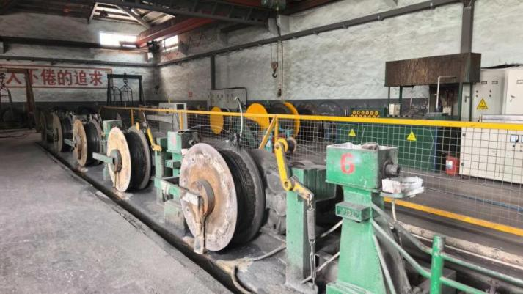
Influence of Drawing Passes on the Performance of Steel Wire
Prestressed steel wires are widely used in infrastructure projects such as Bridges, pile foundations, and sleepers. The stability of their mechanical properties, low relaxation characteristics, and long-term service durability are crucial to the service life and operational safety of prestressed building structures.
As the core process of prestressed steel wire forming, the drawing process, the reasonable configuration of drawing passes, the reduction of area of each pass, the operating speed of the drawing machine and the temperature rise during the forming process are the core process elements for regulating the internal metallographic structure of steel and stabilizing the performance of the finished product.

Slide 5
Influence of Insufficient Drawing Passes on the Performance of Steel Wire
However, at present, some enterprises, in order to cut production costs, simplify the production mode by means of reducing the number of drawing passes, choosing smaller-sized raw material wire rods, and increasing the drawing speed.
Although this type of production method can reduce production input in the short term, it is very likely to damage the internal structure of steel, causing quality defects such as insufficient tensile strength, poor microstructure uniformity, excessive stress relaxation, and substandard hydrogen embrittlement resistance, which poses long-term safety hazards for various infrastructure projects.

Slide 6
Influence of Insufficient Drawing Passes on the Performance of Steel Wire
Affecting Factors | Our Measures | Other Enterprises’ Measures | Influential Mechanism | Potential Consequence
Diameter of wire rods | Match the corresponding specifications according to the standards, as shown in Table 1; | Use smaller diameter wire rods, starting from 5mm steel wire, as shown in Table 2; | The strength of steel wire depends on the work hardening and grain refinement brought about by cold drawing. The small-diameter raw materials result in insufficient total reduction rate, inadequate increase in internal dislocation density, and the grains cannot be fully refined. | The tensile strength of the finished steel wire directly fails to meet the standard. The internal organizational stress distribution is uneven, and brittle fracture is highly likely to occur during subsequent processing or under force.
Drawing Passes | Stepwise drawing with 4-5 passes | Only simple drawing with 2-3 passes | With a fixed total deformation, reducing drawing passes leads to excessive reduction per pass. Severe deformation causes severe stress concentration, resulting in massive dislocation tangling and accumulation, forming coarse dislocation cell structures. | This severely sacrifices the ductility and toughness of the steel wire (with significant reduction in bending and torsion properties), making the wire brittle and degrading its comprehensive mechanical properties.
Wire Drawing Machine Speed | Drawing speed controlled within the range of 80–100 m/min | High-speed drawing at 150–200 m/min | Excessive drawing speed causes intense friction and high temperature, leading to localized softening of the steel wire; meanwhile, asynchronous deformation between the surface and core generates extremely high residual stress. | This results in abnormal sorbite content and excessive relaxation; material softening weakens strength, and internal microcracks are prone to form, significantly reducing the fatigue life of the finished product.

Slide 7
Comparison of the Diameters of Raw Material Wire Rods
Our Factory’s Standard for Finished Prestressed Steel Wires and Corresponding Raw Material Wire Rods:
Table 1
Reference for Non-Standard Raw Material Matching in the Industry:
Table 2
Finished Steel Wire Diameter | Corresponding Wire Rod Diameter | Tensile Strength Grade of Finished Product
4mm | 8mm | 1770MPa
5mm | 10mm | 1770MPa
6mm | 11mm | 1670MPa
7mm | 12.5/13mm | 1670MPa
 | 13.5(Reinforced)/14mm | 1770MPa
Finished Steel Wire Diameter | Corresponding Wire Rod Diameter | Tensile Strength Grade of Finished Product
4mm | 8mm | 1770MPa
5mm | 9mm | 1770MPa
6mm | 9mm | 1670MPa
7mm | 10mm | 1670MPa
Note: To reduce production costs, some enterprises start using smaller-diameter wire rods for 5mm steel wire, as shown in Table 2. Using smaller-diameter raw materials results in insufficient total reduction rate, inadequate increase in internal dislocation density, and incomplete grain refinement.
This directly leads to the finished product failing to meet the tensile strength standard; uneven internal stress distribution also makes brittle fracture highly likely during subsequent processing or under load.

Slide 8
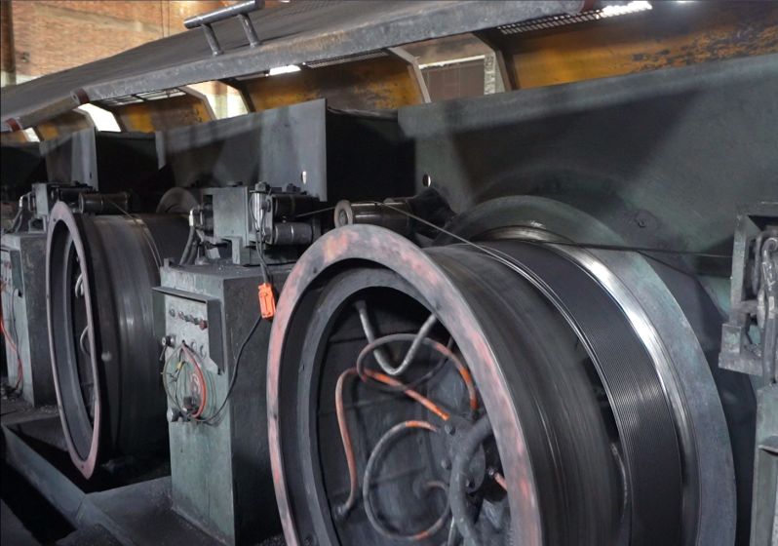
Influence of Insufficient Drawing Passes on the Performance of Steel Wire
Reducing the number of drawing passes leads to significant differences in the degree of deformation between the outer and inner layers of the steel. The surface metal undergoes excessive deformation while the core material experiences insufficient deformation, resulting in disordered internal metallographic structures and large variations in grain size.
This ultimately causes the finished steel wire to have overstated tensile strength, poor toughness, and inferior torsion performance. It is prone to brittle fracture during service, and issues such as wire breakage and structural failure are highly likely to occur under construction tensioning and long-term loading conditions.

Slide 9
The Influence of Drawing Passes and Area Reduction per Pass on the Performance of Steel Wire
02

Slide 10
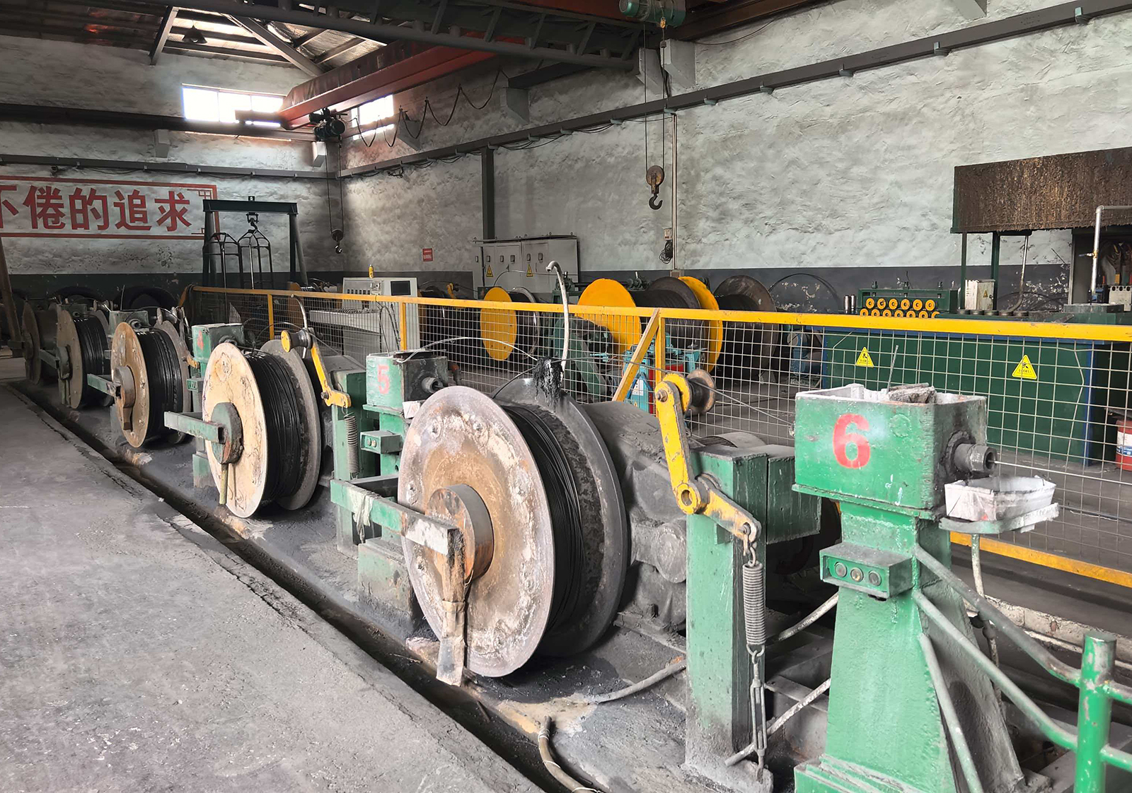
The Influence of Appropriate Drawing Passes on the Performance of Steel Wire
The multi-pass progressive cold drawing of 82B high-carbon steel wire rod enables grain refinement and densification of the sorbite structure, steadily improving the tensile strength, torsion performance and overall structural stability of the steel.
Reasonable planning of drawing passes with uniform and moderate deformation per pass is an important prerequisite for ensuring uniform properties of the finished steel wire and reducing internal residual stress.

Slide 11
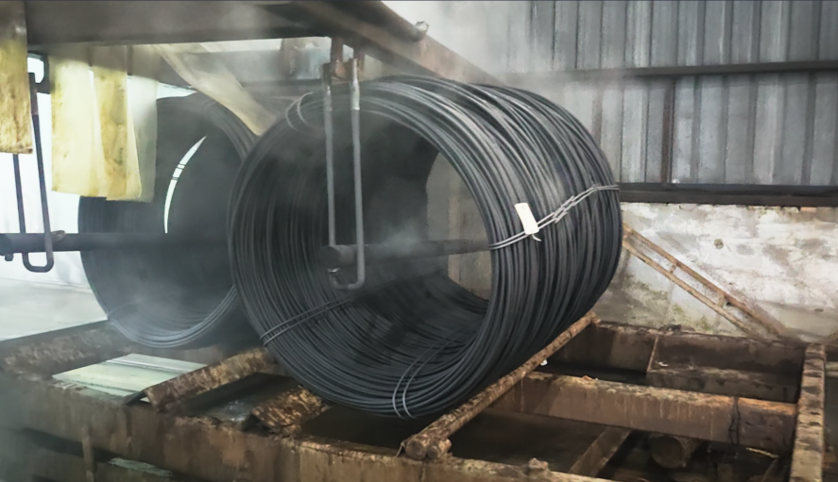
Our Drawing Process
Our factory strictly implements the mature forming process system for prestressed steel wire. We adopt a 4–5 passes progressive drawing production mode, precisely controlling the area reduction per pass to ensure a balanced flow state of the metal material.
This achieves synchronous refinement of the inner and outer structures of the steel, avoiding various material defects caused by unbalanced local deformation.
The base tensile strength of the original 82B high-carbon steel wire rod is 1000–1200 MPa. Through multi-pass gradient drawing, the metal lattice is continuously refined, and the lamellar sorbite structure becomes increasingly dense and uniform, enabling stable processing to specified strength grades such as 1670 MPa and 1770 MPa.

Slide 12
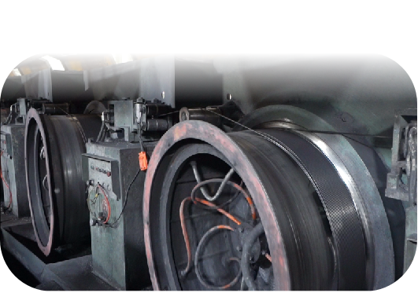
Advantages of a Rational Drawing Process
Process Advantages of Multi-Pass Progressive Drawing:
Uniform and consistent metal deformation, free from surface delamination and stress concentration issues;
Dense and stable sorbite structure, ensuring the finished product meets stress relaxation performance standards;
All mechanical indicators, including tensile strength, percentage elongation after fracture, and number of twists, comply with specifications;
Excellent batch-to-batch performance consistency, supporting third-party testing and on-site sampling verification.
However, to reduce raw material and production costs, some manufacturers simplify the process by using only a 2-3 pass drawing sequence. Insufficient drawing passes force excessive area reduction per pass to achieve the required dimensions.
This improper forced deformation directly affects the stability of the wire's internal structure, posing hidden risks to engineering safety.

Slide 13
The Influence of Simplified Drawing Processes
03

Slide 14
Direct Manifestations of Simplified Drawing Passes
The core reason for the prevalence of simplified drawing passes in the industry is that some enterprises pursue short-term economic benefits unilaterally, which is mainly reflected in two aspects: raw material procurement and production processing.
A drawing process that meets production standards requires matching with large-diameter, high-purity premium 82B high-carbon steel wire rods, leading to relatively high raw material procurement costs.
To control procurement expenses, some enterprises choose non-standard wire rods with smaller diameter specifications and lower prices to reduce raw material procurement costs, participating in low-price market competition by compromising material performance parameters.
(See Page 7)

Slide 15
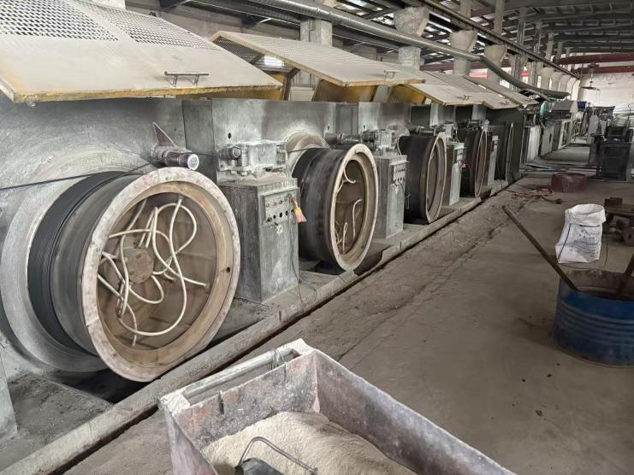
Reducing Production and Processing Costs
The drawing process is a high-energy-consuming step in the steel wire production. Each additional drawing pass will increase multiple production costs, including equipment energy consumption, die wear, and labor hours.
Reducing or streamlining drawing passes can effectively shorten equipment operation time, lower production material consumption, and boost production capacity. While this enables low-cost mass production, it will compromise the core functional performance of the final product.

Slide 16
Mechanism of the Effect of Drawing Speed on Metallographic Structure
04

Slide 17
Mechanism of the Effect of Drawing Speed on Metallographic Structure
The drawing speed of the machine is a key process parameter that is easily overlooked yet directly determines the long-term service performance of steel wire. The raw 82B high-carbon steel wire rod contains 85% sorbite. The finely and uniformly distributed lamellar sorbite serves as the core microstructural foundation for prestressed steel wire to exhibit low relaxation properties, structural stability, and excellent stress corrosion resistance. Uncontrolled temperature during the drawing process will directly damage the high-quality metallographic structure.
High-speed drawing operations generate significant plastic deformation heat and contact surface friction heat, causing the surface temperature of the steel wire to rise rapidly. This directly alters the sorbite metallographic structure inside the steel, which in turn influences the stress relaxation performance and hydrogen embrittlement corrosion resistance of the finished product.

Slide 18
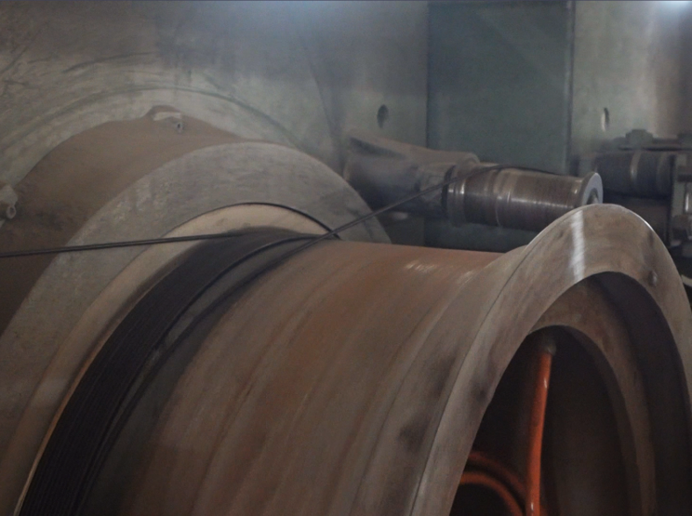
Our Production Model
Our factory rationally plans production operation parameters, controlling the drawing speed within the range of 80-100 m/min, and adopts circulating wire drawing coolant for full-range forced cooling, keeping the steel wire temperature stable at around 150°C throughout the forming process.
Low-speed constant-temperature forming offers multiple advantages:
The temperature rise during drawing is gradual and controllable, preserving the fine lamellar structure of sorbite without high-temperature spheroidization and degradation.
The cold work hardening process proceeds smoothly and orderly, ensuring coordinated and consistent strength, plasticity, and toughness indicators.
Residual stress inside the steel is low, so the finished product meets standard requirements for stress relaxation performance and hydrogen embrittlement resistance.
The finished steel wire has a smooth, clean surface with no surface damage or microcrack defects.

Slide 19
Quality Risks Caused by High-Speed Drawing
Some enterprises raise the drawing speed to 150-200 m/min to boost production capacity. High-speed drawing generates significant plastic deformation heat and friction heat, causing the surface temperature of the steel wire to rise rapidly. This keeps the steel wire at high temperatures for extended periods, triggering irreversible degradation of material performance.
First, degradation and alteration of the metallographic structure. The high-temperature environment promotes the spheroidization of the sorbite lamellar structure, drastically reducing structural density. This directly leads to excessive stress relaxation indicators in the steel wire, accelerating prestress loss during long-term use and weakening the overall bearing capacity of the building structure.
Second, increased surface defects in the steel. High-speed friction easily forms microcracks on the surface, aggravating metal lattice distortion and expanding hydrogen absorption channels in the steel. As a result, the finished product fails hydrogen embrittlement resistance tests, and its overall stress corrosion resistance declines significantly.
Third, a drastic reduction in the product’s overall service life. Hidden material defects caused by high-temperature forming do not appear at the factory stage, but accelerate material aging under long-term loads and outdoor corrosive environments, leading to premature performance degradation and component failure.

Slide 20
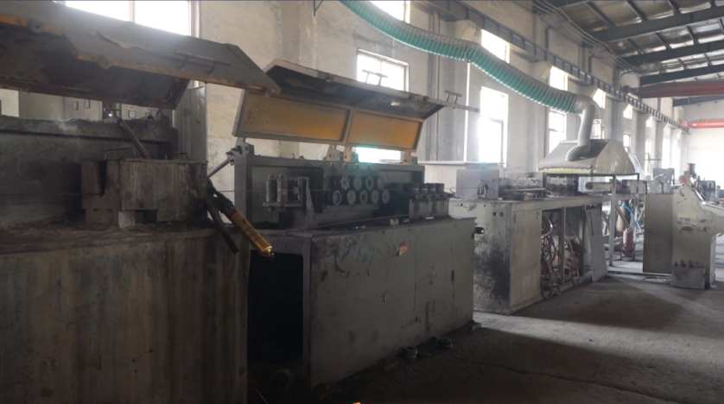
Elongation After Fracture Standard
The initial elongation of the raw material wire rod is approximately 10%. As the drawing passes progress, the elongation after fracture of the steel wire will show a gradual downward trend.
Our factory strictly controls all process parameters throughout production to ensure the elongation after fracture of the finished product meets the national standard requirement of 3.5%, balancing structural strength and operational safety.

Slide 21
Engineering Hazards Caused by Non-Standard Drawing Processes
05

Slide 22
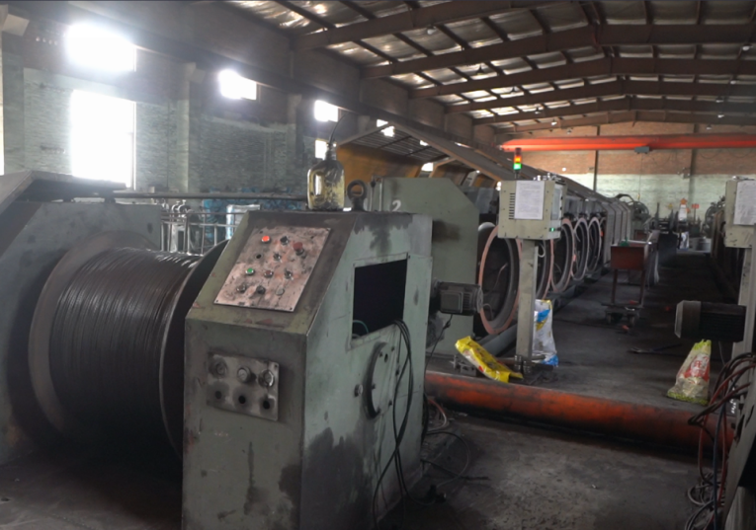
Engineering Hazards Caused by Non-Standard Drawing Processes
Non-standard production methods such as reducing drawing passes, using non-standard small-diameter wire rods, and over-speed high-temperature forming will cause a comprehensive decline in all core functional properties of prestressed steel wire, leading to multiple engineering safety hazards.
Insufficient Structural Load-Bearing Capacity
Steel wires processed with non-standard processes lack effective strength reserve and exhibit high brittleness. They are prone to brittle fracture during construction tensioning operations and cannot meet the load-bearing standards specified in the engineering design.
Significant Degradation in Service Durability
Finished products often fail stress relaxation tests, have weak hydrogen embrittlement resistance, and contain numerous surface micro-defects. Under long-term constant stress and complex alternating wet/dry, corrosive conditions, the material aging rate accelerates, making premature failure highly likely.
Residual Safety Risks
Prestressed steel wires are the core load-bearing components in bridges, pile foundations, railway sleepers, water conservancy facilities, and other projects. Insufficient product performance stability not only shortens the overall service life of the building project, but in severe cases, can also lead to major safety accidents such as structural deformation and wall cracking.

Slide 23
Our Process & Quality Assurance
06

Slide 24
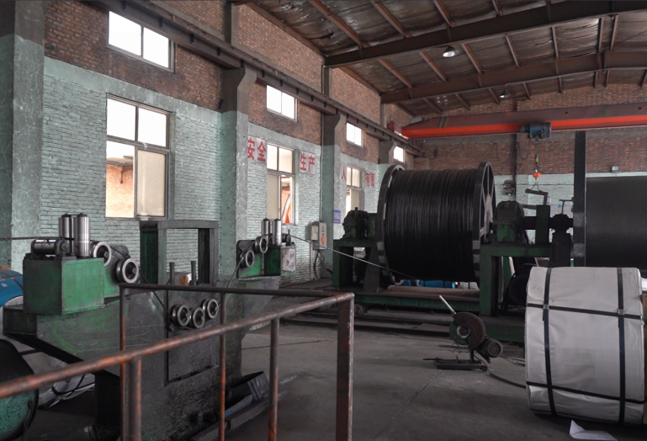
Process & Quality Assurance
As an enterprise specializing in the production of prestressed steel wire and steel strand, we fully recognize the critical importance of process control to the quality and safety of infrastructure projects. We consistently reject low-cost, low-quality production models, adhere to standardized multi-pass drawing processes, and implement low-speed constant-temperature forming technology. All production parameters are controlled in strict accordance with the latest national standard GB/T 5224-2023.
All products leaving our factory are subject to comprehensive verification by third-party professional testing institutions. We implement full-process quality control from raw material selection and process forming to finished product inspection, effectively avoiding all potential hidden quality defects. We provide high-quality building materials that deliver stable performance, safety, reliability, and long-term durability for large and medium-sized prestressed infrastructure projects.
If you need to purchase or consult about prestressed steel wire, prestressed steel strand, or related products, please contact us via the phone and email addresses listed on our website.
Welcome your inquiries and cooperation!

Slide 25
THANKS FOR LISTENING

